Slide 1
Pub/Sub for WSN – Application Scenarios in Traffic Management
Steven Lai

Slide 2
Application Scenario 1 – Traffic Light Controlling
Traffic light should be adjusted according to the length of the vehicle queue.
Traffic light is located at the end of the road so it only knows how many vehicles have left.
Sensors at the beginning of the road knows about the how many vehicles have entered the road.
If we know how many vehicles have entered and how many vehicles have left, we can get the length of the queue.

Slide 3
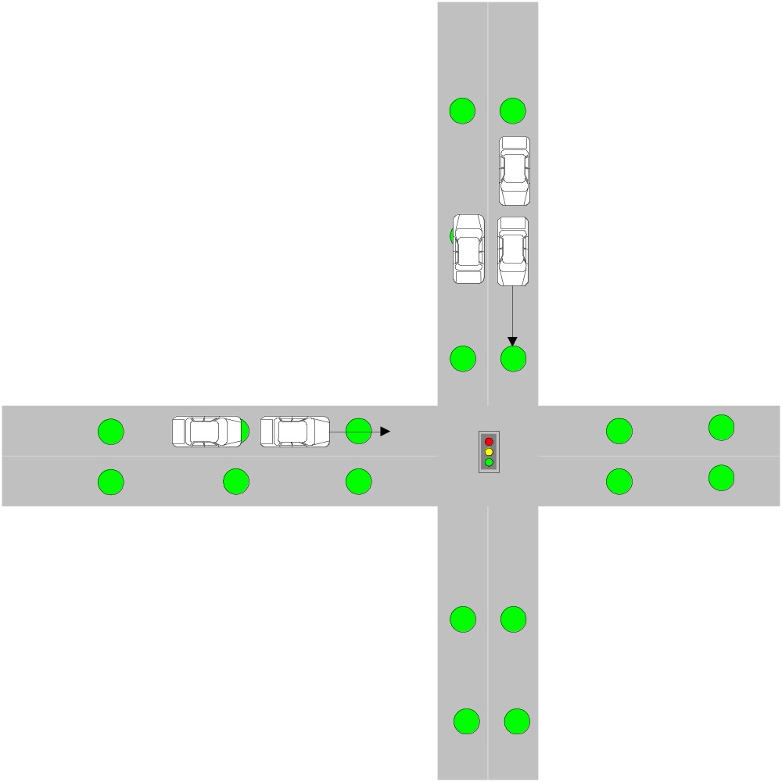
Application Scenario 1

Slide 4
Application Scenario 1
Publishers: Sensors at the beginning of the road.
Subscribers: Traffic Light Controllers.
Broker: Vehicles
Multiple Publishers -> One Subscriber

Slide 5
Application Scenario 2 – Error Rate Estimation
Extension of the first idea.
Not only does the traffic light controller need the traffic flow information, but also do other sensors need such kind of information.
Those sensors need such kind of information so that they can estimate how many cars are not detected (error rate).
Based on the error rate, those sensors can dynamically adjust their random wake-up time.

Slide 6
Application Scenario 2
Publishers: Sensors at the beginning of the road.
Subscribers: All the sensors on the road.
Broker: Vehicles
One Publisher -> Multiple Subscriber

Slide 7
Application Scenario 3 – Information Dissemination to Static Stations
Extension to the first 2 ideas.
A few static stations are deployed by the roads.
Those static stations are connected to the Internet and they collect traffic flow information on different roads.
Traffic light controllers will be information dissemination centers because they know about the traffic flow.

Slide 8
Application 3
Publishers: Traffic light controllers.
Subscribers: Static stations.
Brokers: Vehicles and sensor nodes.
Multiple publishers -> Multiple subscribers
Ferry-aided routing.
Subscription can be made depending on the flow / direction of the traffic.

Slide 9
Application Scenario 4 – Information Dissemination to Mobile Nodes
Extension to the 3rd idea.
Traffic flow information is now disseminated to the moving vehicles as well.
Traffic controllers disseminate traffic flow information to certain roads so that drivers on those roads can avoid traffic jams

Slide 10
Application Scenario 4
Publishers: Traffic light controllers.
Subscribers: Vehicles.
Brokers: Vehicles and sensor nodes.
Multiple publishers -> Multiple subscribers

